Slide 1


A
Project
by
Jahnavi Tejomurtula
Ashmita Chakraborty
Abhash Malviya
Abhilash Naredla
Under the guidance of
Prof. Dr. Nader F Mir
DEVELOPMENT OF MULTI-LAYERED DATA CENTER ARCHITECTURES
USING
SOFTWARE DEFINED NETWORKING
Department of Electrical Engineering

Slide 2

INTRODUCTION
Need for Data Center Network
Increased need for data availability and better performance
To Enable large storage domain and faster network switching
What is a Data Center Network
Need for a Scalable network
Need for a Software defined Control
A collection of storage and network devices connected over a communication channel
A Network which provides a virtualized environment
Maximizing flexibility, increasing design life cycle
Decreasing cost of the network and latency
Increased processing delays, physical switching requirements due to control and data operating in parallel
Software Defined Networking
Decoupled control logic from data plane which shifts the control on network to a centralized controller
Decreases the physical management costs and improves operational flexibility

Slide 3
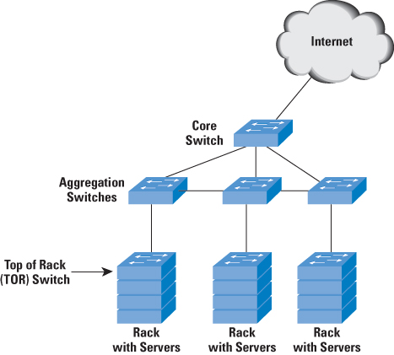
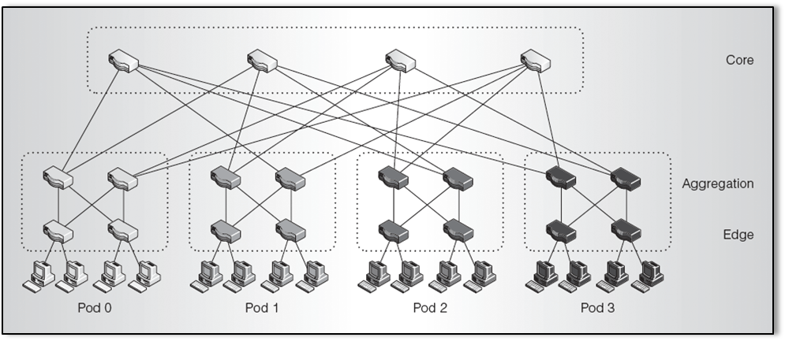
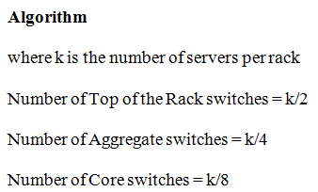
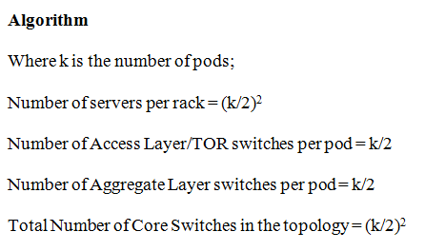
INTRODUCTION
SJSU Washington Square
Multi-Tier Architecture
Fat tree Architecture

Slide 4
INTRODUCTION: PROGRAM FLOW & TOOLS
PROGRAM FLOW
TOOLS USED
IPERF- BANDWIDTH CALCULATION
Mininet> iperf <Source Host Name> <Destination Host Name>
*** Iperf: testing TCP bandwidth between <Source Host Name> and <Destination Host Name>
*** Results: ['1.69 Gbits/sec', '1.70 Gbits/sec']
PINGALLFULL-DELAY CALCULATION
Mininet> pingallfull
Mininet- SDN Simulator
Ovs-vsctl – Open VSwitch Command Line
Python API

Slide 5
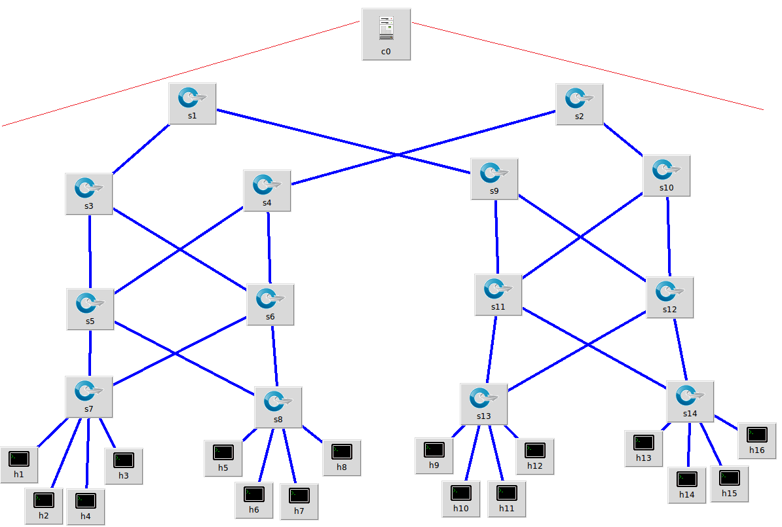
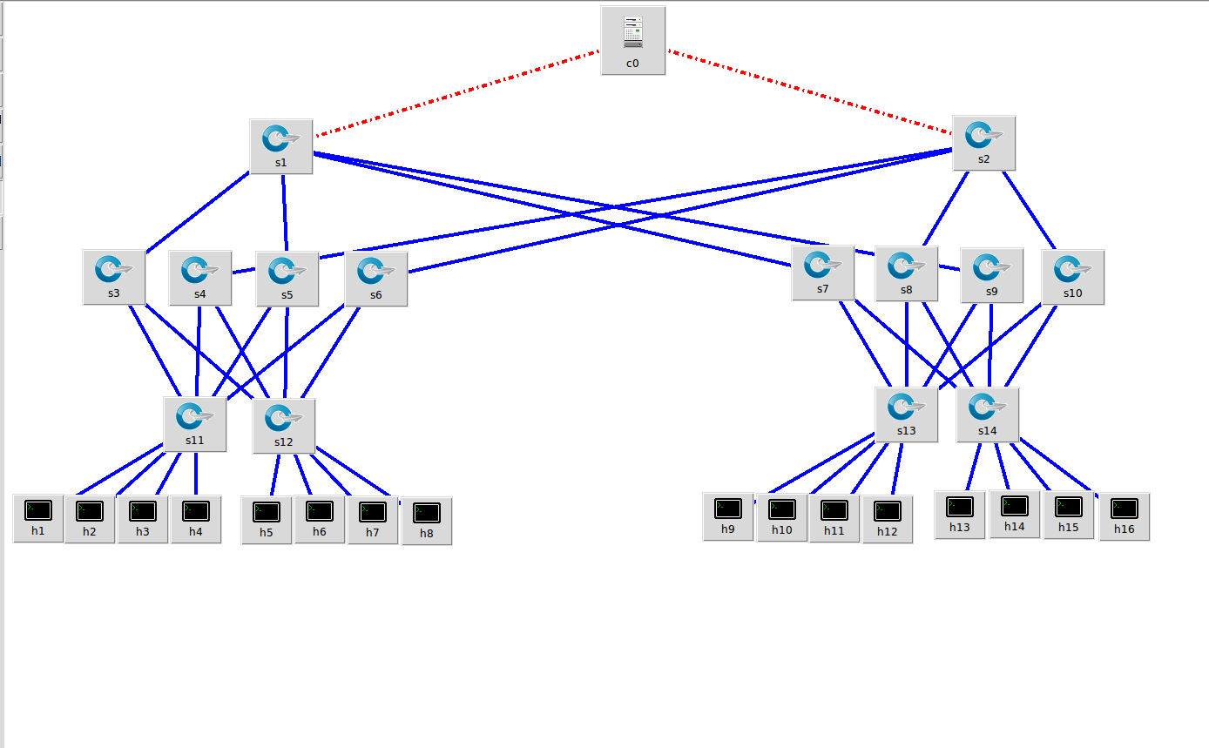
FAT TREE ARCHITECTURES
ton Square
16 Host Architecture: 4 Racks and 4 Hosts per Rack
Layered Architecture
Non-Layered Architecture

Slide 6
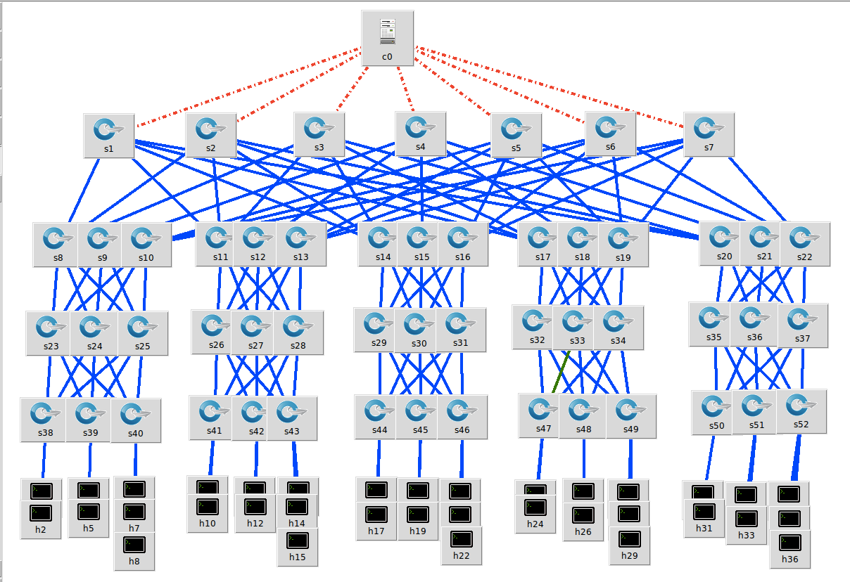
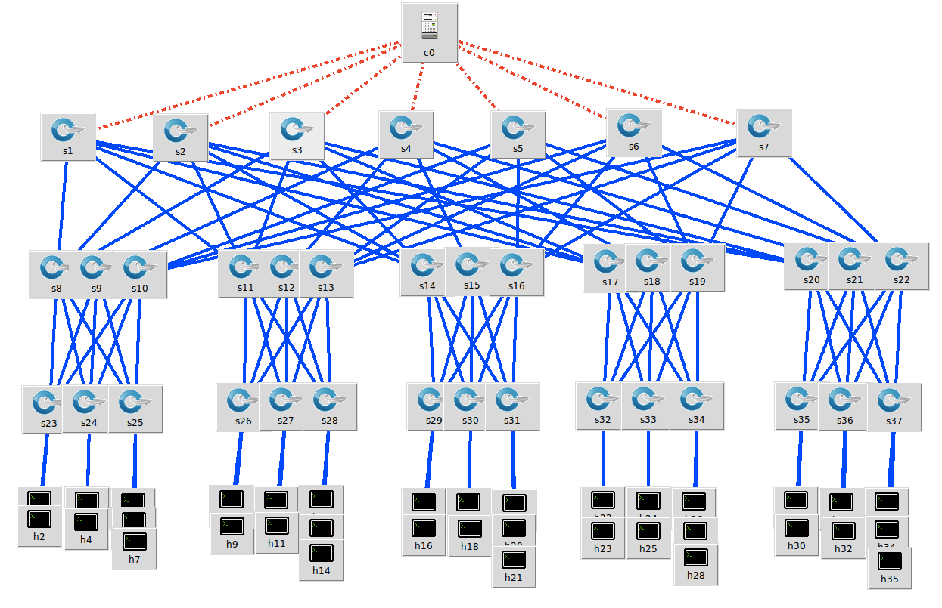
FAT TREE ARCHITECTURES
ton Square
35 Host Architecture: 5 Racks and 7 Hosts per Rack
Layered Architecture
Non-Layered Architecture

Slide 7
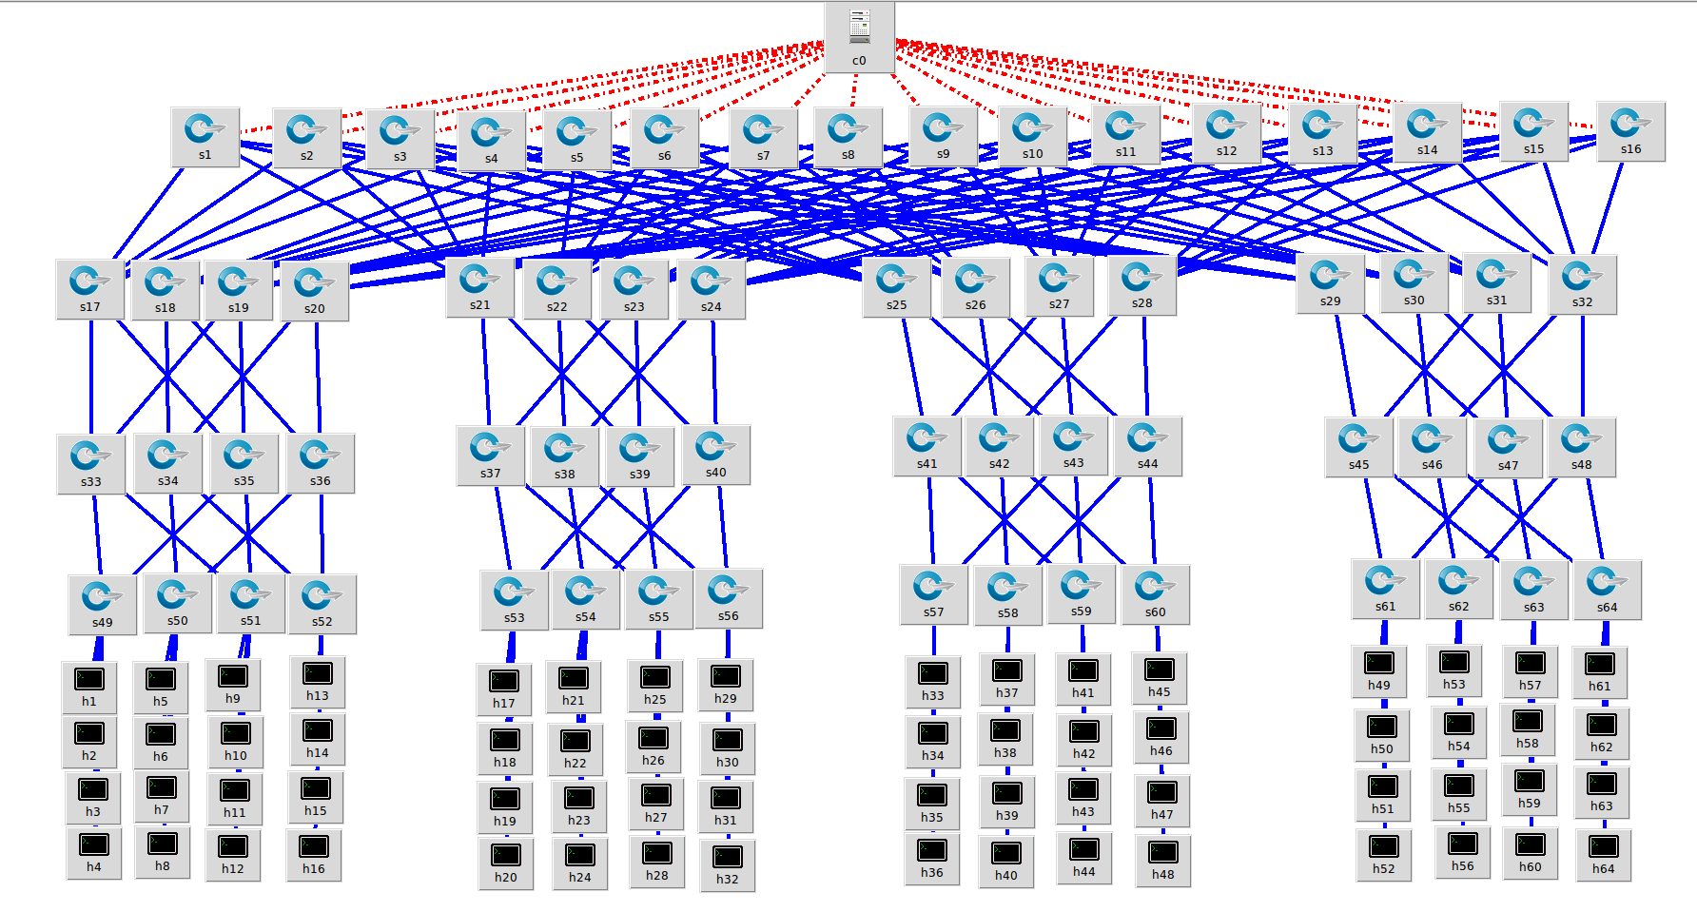
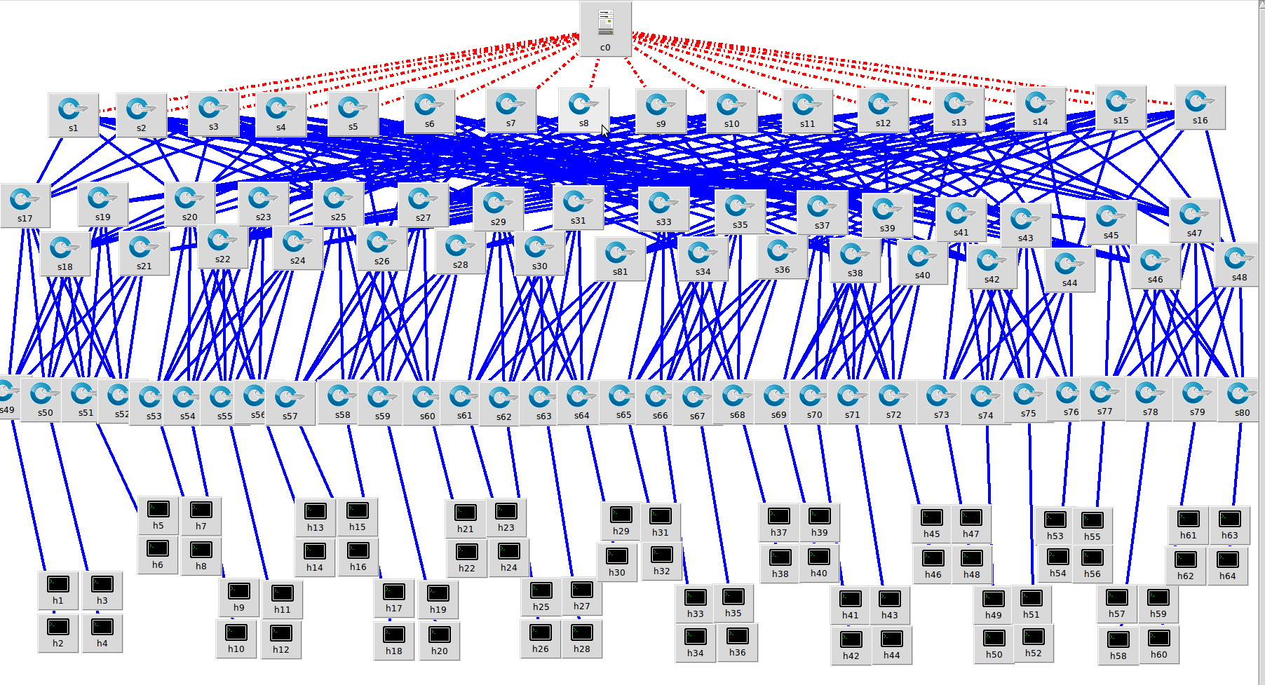
FAT TREE ARCHITECTURES
ton Square
64 Host Architecture: 6 Racks and 8 Hosts per Rack
Layered Architecture
Non-Layered Architecture

Slide 8
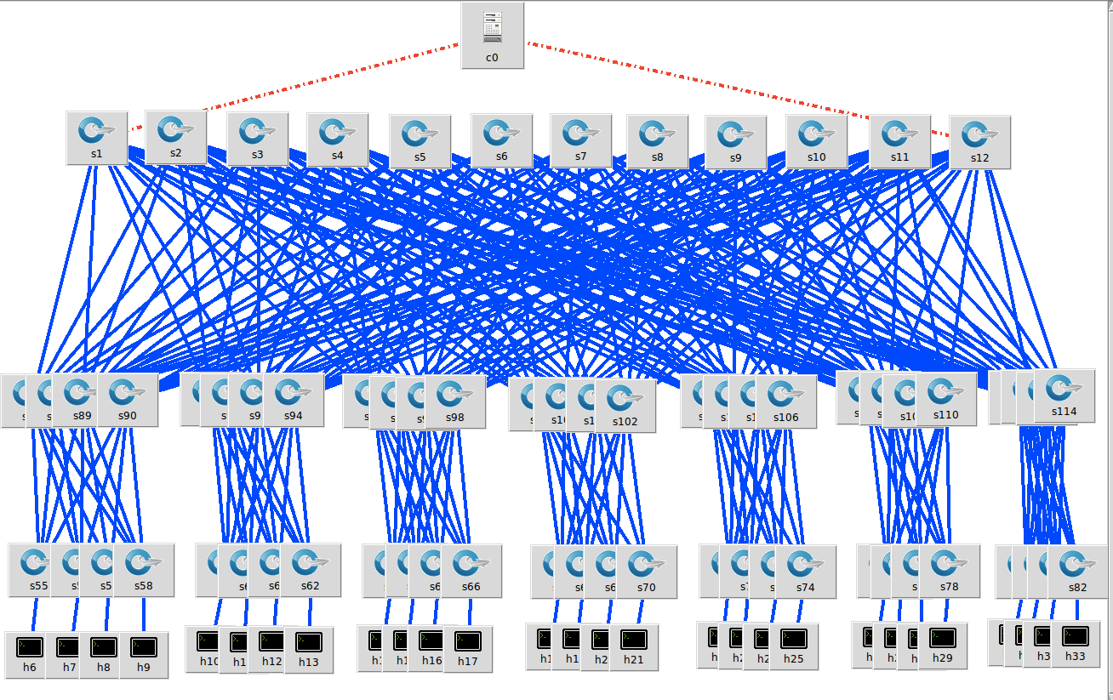
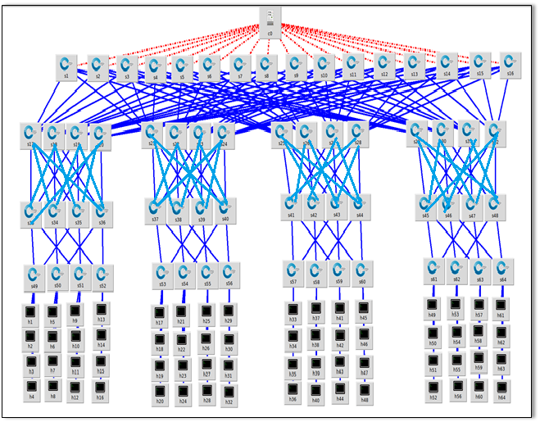
FAT TREE ARCHITECTURES
ton Square
98 Host Architecture: 7 Racks and 14 Hosts per Rack
Layered Architecture
Non-Layered Architecture

Slide 9
FAT TREE ARCHITECTURES
ton Square
Overall Delay- Bandwidth Analysis of Fat-Tree Architectures

Slide 10
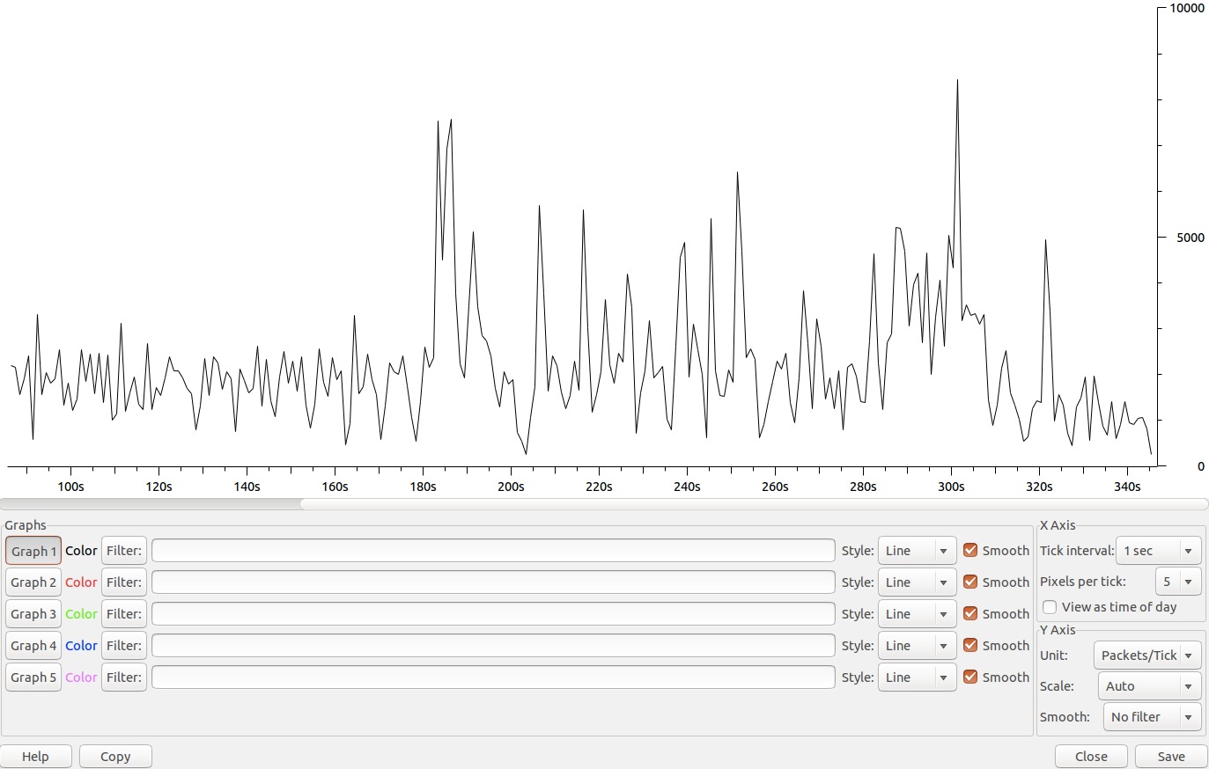
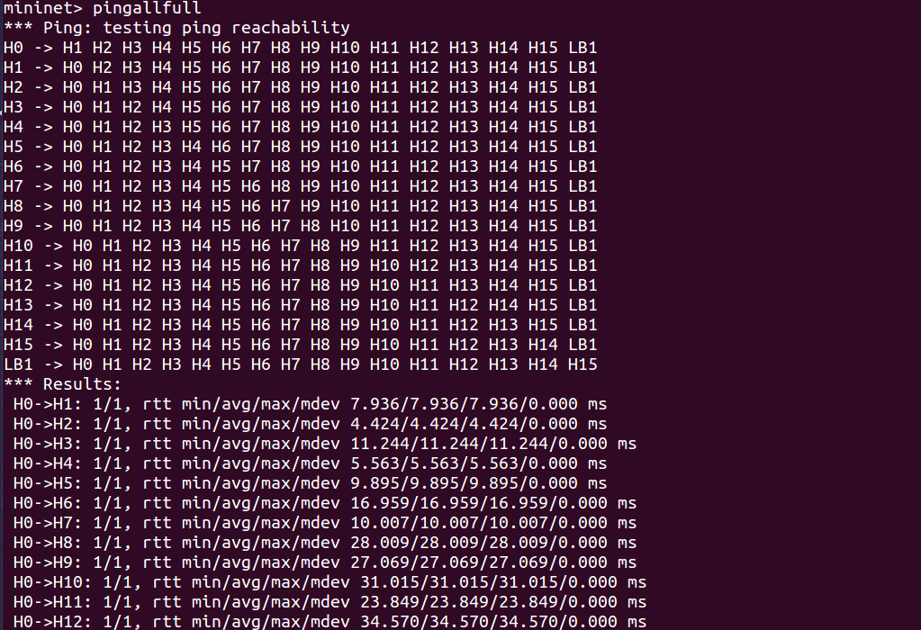
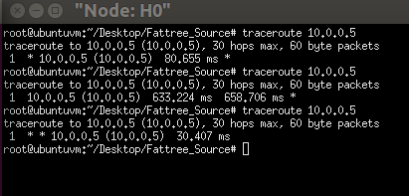
FAT TREE ARCHITECTURES
ton Square
Quantitative Analysis for Fat Tree Architecture
IO Data Analysis Using Wireshark
Throughput Analysis Using Wireshark
Pingallfull from Mininet
Traceroute from Mininet

Slide 11
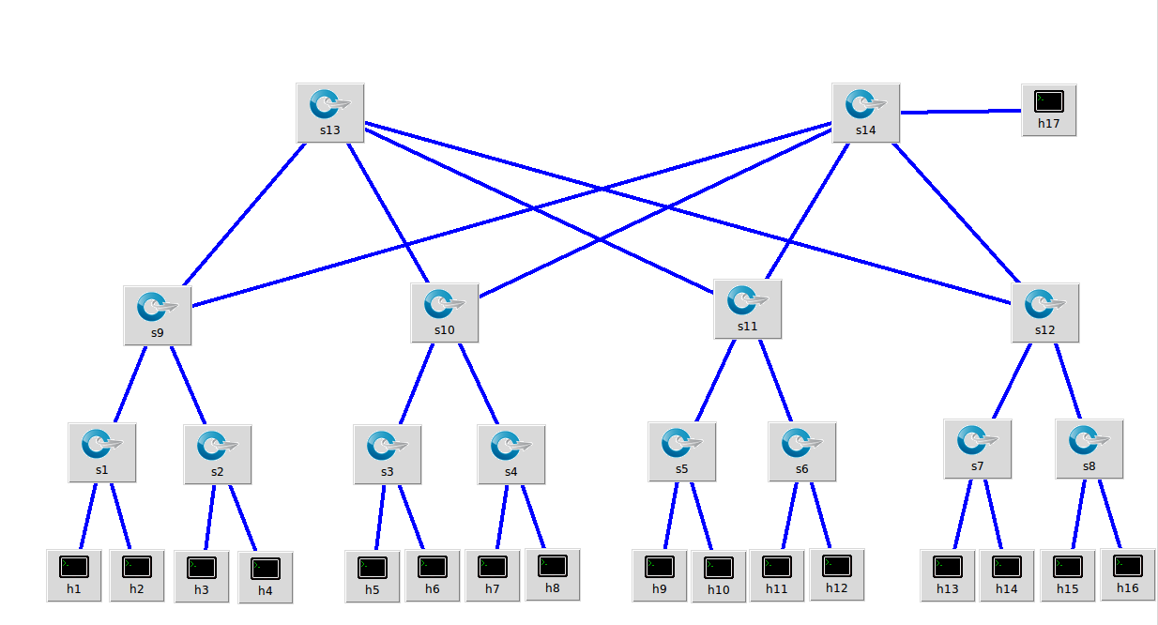
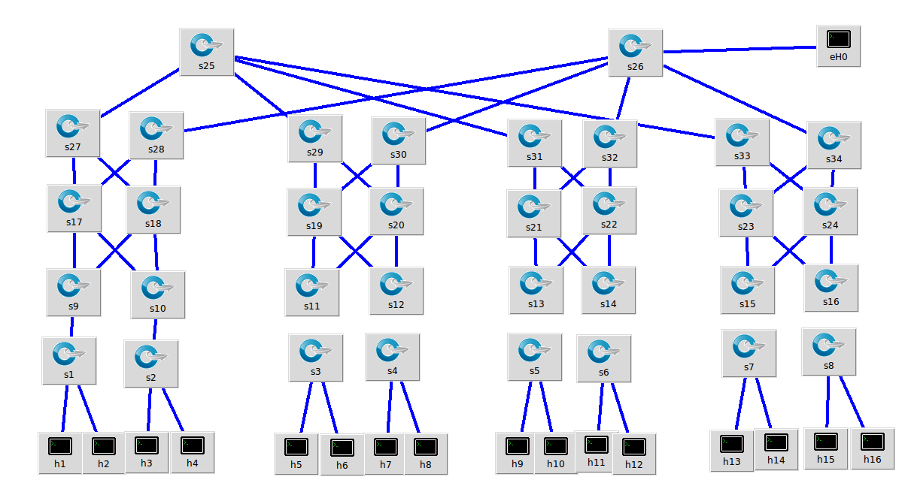
MULTI-TIER ARCHITECTURES
Architecture with 16 Hosts; 4 Racks and 4 Hosts per rack
16 Hosts Non-Layered
16 Hosts Layered

Slide 12
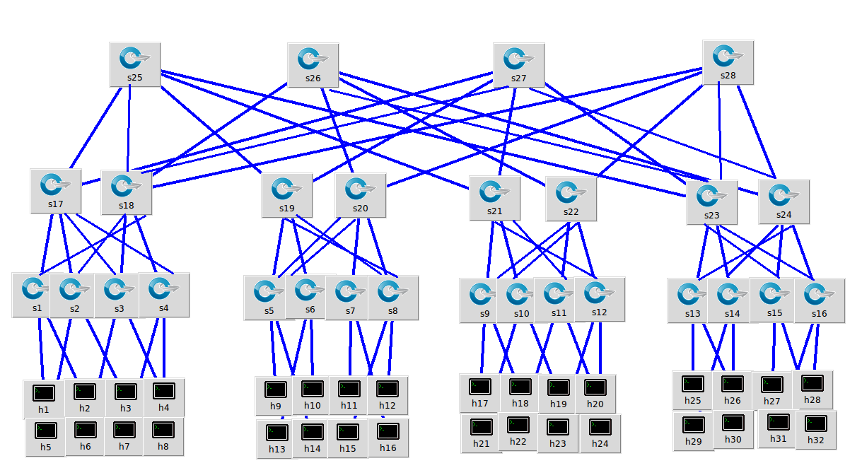
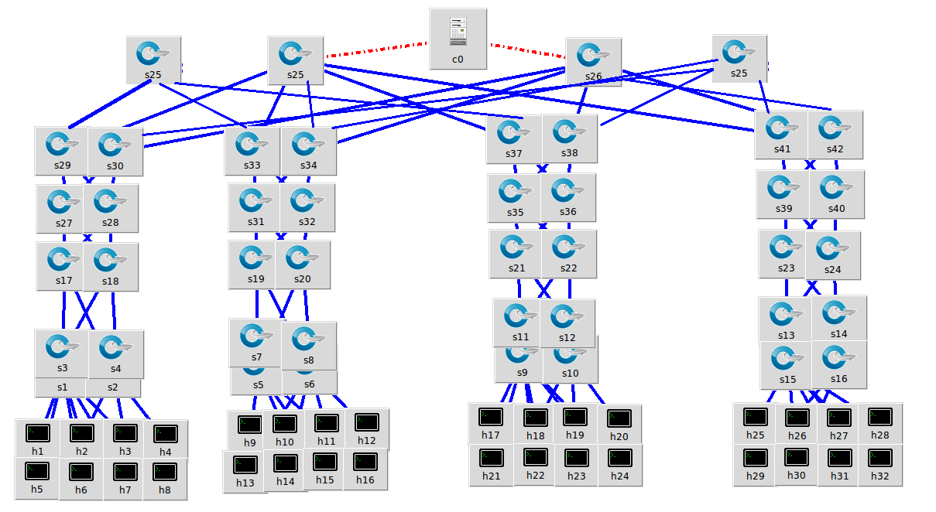
MULTI-TIER ARCHITECTURES
Architecture with 32 Hosts; 4 Racks and 8 Hosts per rack
32 Hosts Non-Layered
32 Hosts Layered

Slide 13
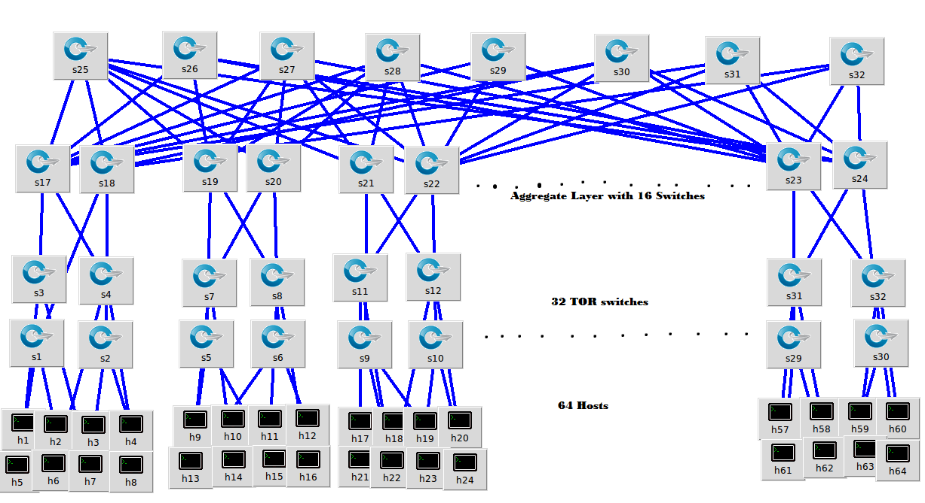
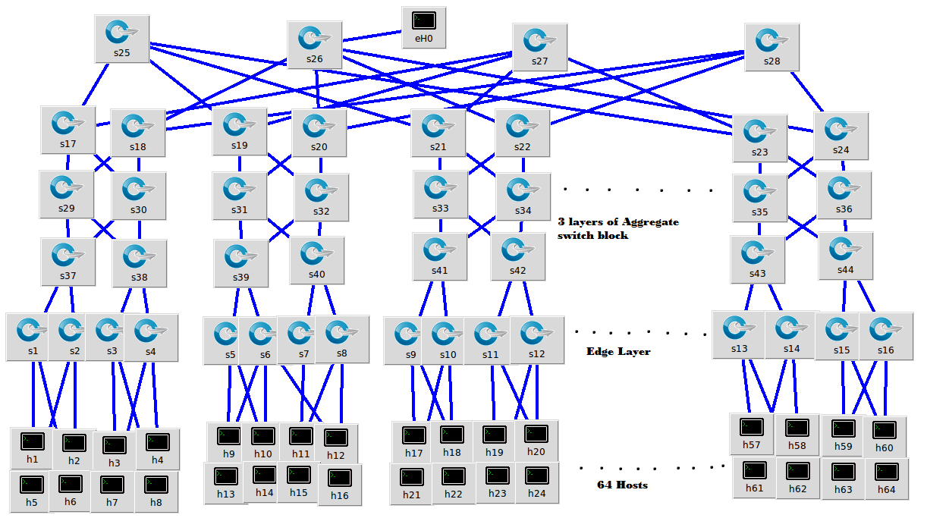
MULTI-TIER ARCHITECTURES
Architecture with 64 Hosts; 8 Racks and 8 Hosts per rack
64 Hosts Non-Layered
64 Hosts Layered

Slide 14
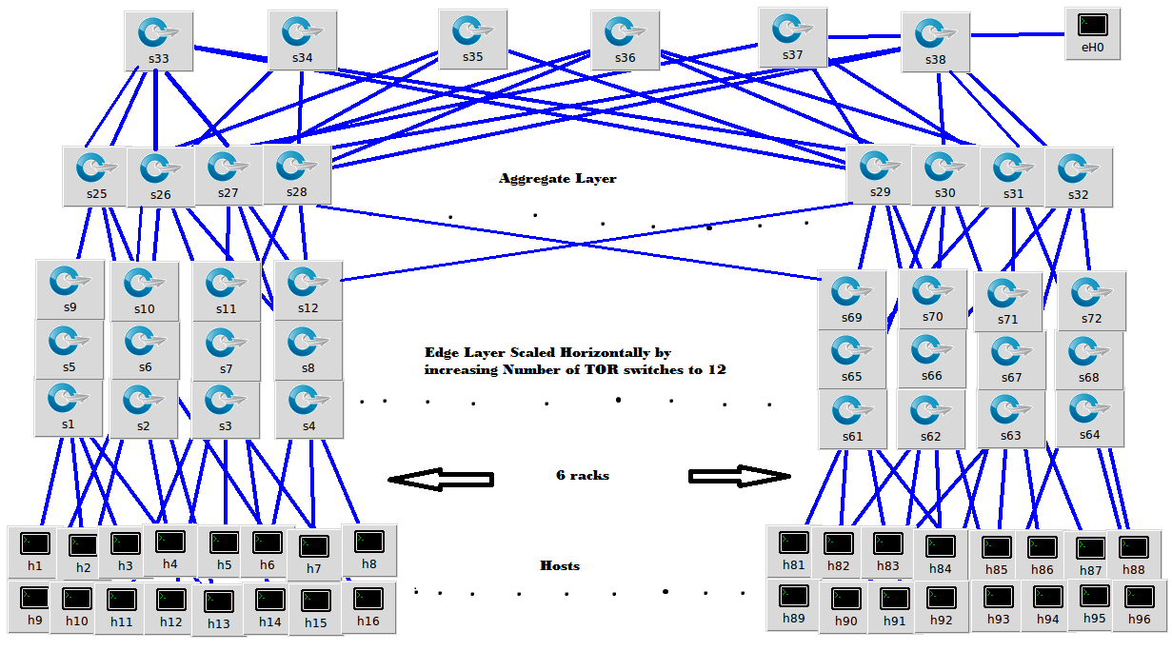
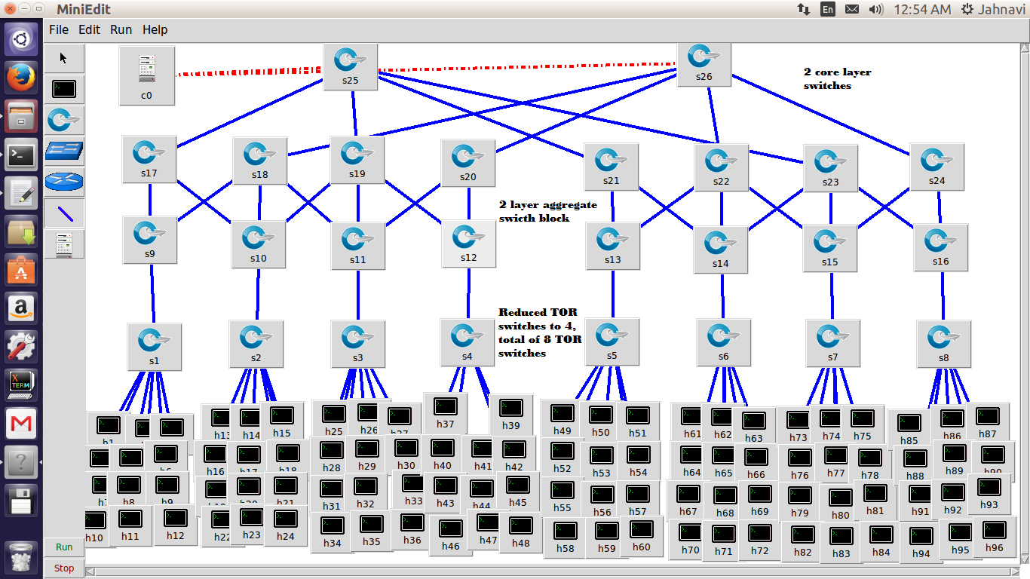
MULTI-TIER ARCHITECTURES
Architecture with 96 Hosts; 2 Racks with 48 servers and 6 racks with 16 servers each
96 Hosts Horizontally Scaled
96 Hosts Vertically Scaled

Slide 15
Overall Delay-Bandwidth analysis Multi-Tier architecture
MULTI-TIER ARCHITECTURES
SJSU Washington Square

Slide 16
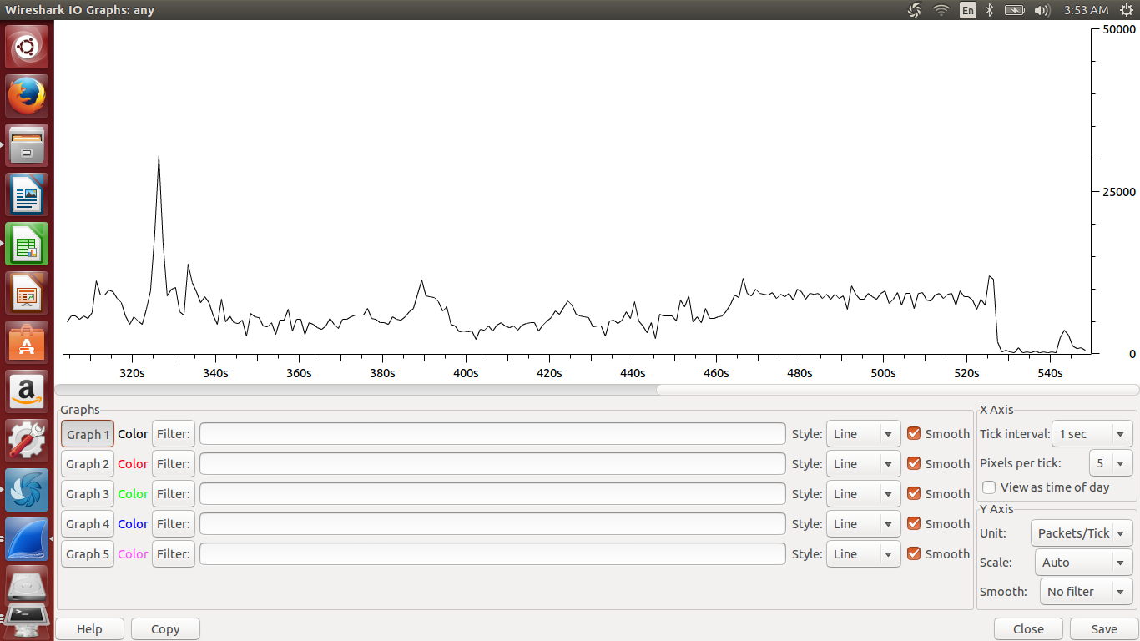
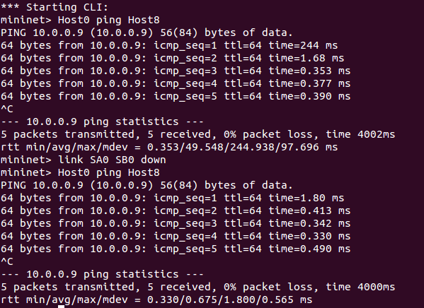
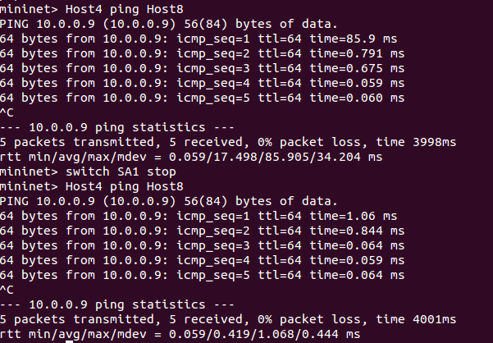
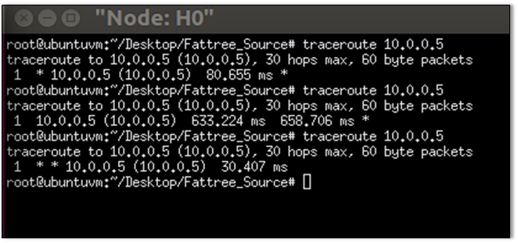
MULTI-TIER ARCHITECTURES
Quantitative Analysis
IO Data Analysis using Wireshark
Packet inspection using Mininet commands; Link, Switch and Traceroute

Slide 17
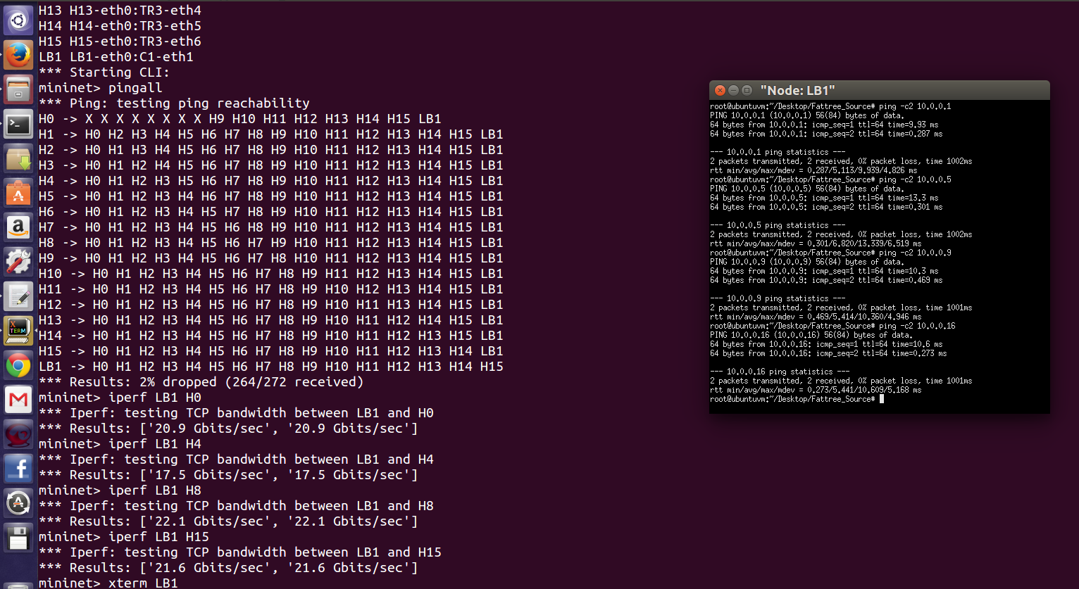
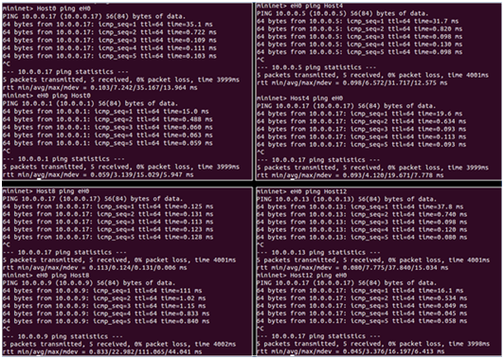
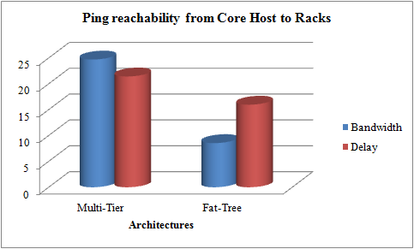
COMPARATIVE ANALYSIS FOR FAT-TREE AND MULTI-TIERED ARCHITECTURE
ton Square
16 Host Core-Host Communication: Fat Tree Architecture
16 Host Core-Host Communication: Multi-Tiered Architecture

Slide 18
COMPARATIVE ANALYSIS FOR FAT-TREE AND MULTI-TIERED ARCHITECTURE
ton Square
Average Delay and Average Bandwidth Comparison of Fat Tree and Multi-tiered Architectures

Slide 19
CONCLUSION
Multi-Tier Architecture
Offers better Bandwidth when vertically scaled
Higher Average Delay
Fat-Tree Architecture
Offers lower delay
Increased number of switches increases network complexity
Offers less bandwidth when scaled
Multi-Tier Architecture is better suited for vertical scaling

Slide 20
REFERENCES
Software Defined Networks (EWSDN), 2013 Second European Workshop on, Issue Date: 10-11 Oct. 2013, Written by: Teixeira, J.; Antichi, G.; Adami, D.; Del Chiaro, A.; Giordano, S.; Santos, A.
M. Al-Fares, A. Loukissas, and A. Vahdat, ``A scalable, commodity datacenter network architecture,'' in Proc. ACM SIGCOMM, 2008, pp. 63_74.
T. Lam et al., ``NetShare: Virtualizing data center networks across ser-vices,'' Dept. Comput. Sci. Eng., Univ. California, Berkeley, CA, USA, Tech. Rep., 2010.
TING WANG1, (Student Member, IEEE), ZHIYANG SU1 , (Student Member, IEEE), YU XIA1 , (Member, IEEE), AND MOUNIR HAMDI1,2 , (Fellow, IEEE) Department of Computer Science and Engineering, The Hong Kong University of Science and Technology, Hamad Bin Khalifa University, Doha, Qatar “ Rethinking the Data Center Networking:Architecture, Network Protocols and Resource Sharing “, 2013

Slide 21



